Slide 1
Project 3: Creating Semaphores
CSCE351: OS Kernels

Slide 2
Additional Resources
I have provided a zip file that has a working implementation of the scheduler (project 2) and basic function prototype for semaphores
You can use this resource even if you second project works
No penalty for using this resource

Slide 3
Thread States
You need 1 bear and 10 honey bees threads
You should have the following states:
New
Ready
Running
Blocked on semaphore
Terminated

Slide 4
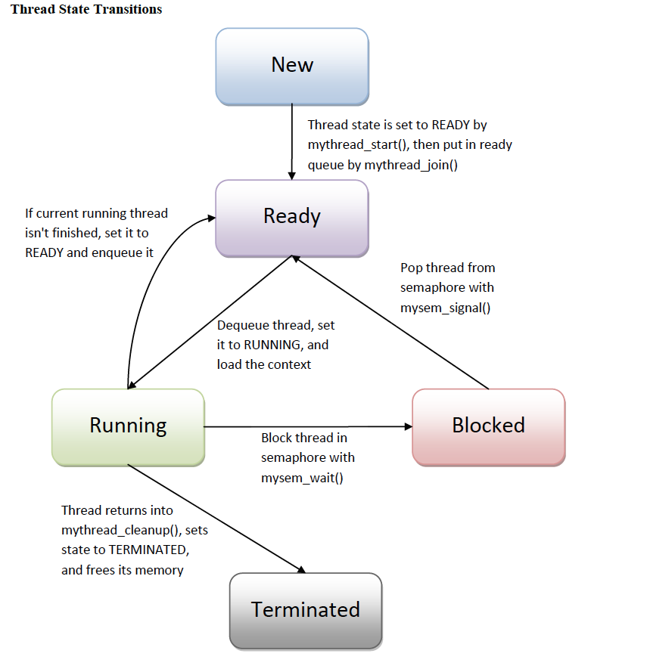

Slide 5
Semaphore Specification
your_structure_type* mysem_create( int value ) | // It returns the starting address a semaphore variable and initialize the semaphore value. You can use malloc() to allocate memory space.
void mysem_up( your_structure_type* sem ) | // It performs the semaphore’s up operation.
void mysem_down( your_structure_type* sem ) | // It performs the semaphore’s down operation.
void mysem_delete( your_structure_type* sem ) | // It deletes the memory space of a semaphore.
the size of the honey pot | // 30

Slide 6
Semaphores
your_structure_type* mysem_create( int value ) | // It returns the starting address a semaphore variable. You can use malloc() to allocate memory space and initialize the internal data structure of the semaphore based on provided parameter.
void mysem_up( your_structure_type* sem ) | // It performs the semaphore’s increment operation. Increment the value of the semaphore. If one or more threads are sleeping on the semaphore, the one that has been sleeping the longest is allowed to complete its down operation. As such, after an up on a semaphore with threads sleeping on it, the semaphore value is still 0 but there is one fewer sleeping threads.
void mysem_down( your_structure_type* sem ) | // It performs the semaphore’s decrement operation. Check to see if the semaphore value is greater than 0. If so, it decrements the value and just continues. If the value is 0, the thread is put to sleep without completing the down for the moment. As such, the semaphore value never falls below 0.
void mysem_delete( your_structure_type* sem ) | // It deletes the memory space of a semaphore.
int mysem_waitCount( your_structure_type* sem) | // Return the number of threads sleeping on the semaphore.
int mysem_value( your_structure_type* sem) | // Return the current value of the semaphore.

Slide 7
Semaphore Struct
At least it would need the following:
Need sem_count, which is the value of the semaphore
Need # of waiting thread, which is the number of threads that is waiting on the semaphores
TCB* queue[], hold TCBs of blocked threads

Slide 8
Atomic Section
mysem_up and mysem_down must be atomic otherwise, you can have inconsistent semaphore values
No TSL or XCHG so you need to disable interrupt upon entering you atomic section and then enable it when you exit

Slide 9
Needed Semaphores
pot_full
Initialized to 0 (pot not full at the beginning)
Mutex
Provide mutual exclusion for honeypot accesses
Initialized to 1

Slide 10
Bear and Honey Bees
There are 10 honeybees and a bear. They share a pot of honey. The pot is initially empty; its capacity is 30 equal-portions of honey. Each bee repeatedly gathers one portion of honey and puts it in the pot.
In its life, each bee will gather 15 portions of honey before it dies.
The bee that fills the pot awakens the bear.
The bear sleeps until the pot is full, then eats the entire pot of honey and goes back to sleep.
The bear wakes up to consume the honey 5 times.

Slide 11
Bear and Honey Bees (General Solution)
sem mutex = 1, pot_full = 0;
int portions = 0;
process bear {
while (true) {
down(pot_full);
eat_all_honey();
portions = 0;
up(mutex);
}
}
process honeybee[I=1 to 10]
while (true) {
collect_honey();
down(mutex);
fill_pot();
portion++;
if (portions == H)
up (pot_full);
else
up (mutex);
}
}

Slide 12
Bear and Honey Bees
sem mutex = 1, pot_full = 0;
int portions = 0;
process bear {
while (true) {
down(pot_full);
eat_all_honey();
portions = 0;
up(mutex);
}
}
bear
bee
bee
bee
bee
Portions = 0
bee
bee
bee
bee
bee
bee
pot_full
mutex

Slide 13
Bear and Honey Bees
sem mutex = 1, pot_full = 0;
int portions = 0;
process bear {
while (true) {
down(pot_full);
eat_all_honey();
portions = 0;
up(mutex);
}
}
bear
bee
bee
bee
bee
Portions = 0
bee
bee
bee
bee
bee
bee
pot_full
mutex

Slide 14
Bear and Honey Bees
process honeybee[I=1 to 10]
while (true) {
collect_honey();
down(mutex);
fill_pot();
portion++;
if (portions == H)
up (pot_full);
else
up (mutex);
}
}
bee
bee
bee
bee
Portions = 0
bee
bee
bee
bee
bee
bee
pot_full
bear
mutex

Slide 15
Bear and Honey Bees
process honeybee[I=1 to 10]
while (true) {
collect_honey();
down(mutex);
fill_pot();
portion++;
if (portions == H)
up (pot_full);
else
up (mutex);
}
}
bee
bee
bee
bee
Portions = 0
bee
bee
bee
bee
bee
bee
pot_full
bear
mutex

Slide 16
Bear and Honey Bees
process honeybee[I=1 to 10]
while (true) {
collect_honey();
down(mutex);
fill_pot();
portion++;
if (portions == H)
up (pot_full);
else
up (mutex);
}
}
bee
bee
bee
bee
Portions = 0
bee
bee
bee
bee
bee
bee
pot_full
bear
mutex

Slide 17
Bear and Honey Bees
process honeybee[I=1 to 10]
while (true) {
collect_honey();
down(mutex);
fill_pot();
portion++;
if (portions == H)
up (pot_full);
else
up (mutex);
}
}
bee
bee
bee
bee
Portions = 0
bee
bee
bee
bee
bee
bee
pot_full
bear
mutex

Slide 18
Bear and Honey Bees
process honeybee[I=1 to 10]
while (true) {
collect_honey();
down(mutex);
fill_pot();
portion++;
if (portions == H)
up (pot_full);
else
up (mutex);
}
}
bee
bee
bee
bee
Portions = 1
bee
bee
bee
bee
bee
bee
pot_full
bear
mutex

Slide 19
Bear and Honey Bees
process honeybee[I=1 to 10]
while (true) {
collect_honey();
down(mutex);
fill_pot();
portion++;
if (portions == H)
up (pot_full);
else
up (mutex);
}
}
bee
bee
bee
bee
Portions = 1
bee
bee
bee
bee
bee
bee
pot_full
bear
mutex

Slide 20
Bear and Honey Bees
process honeybee[I=1 to 10]
while (true) {
collect_honey();
down(mutex);
fill_pot();
portion++;
if (portions == H)
up (pot_full);
else
up (mutex);
}
}
bee
bee
bee
bee
Portions = 2
bee
bee
bee
bee
bee
bee
pot_full
bear
mutex

Slide 21
Bear and Honey Bees
process honeybee[I=1 to 10]
while (true) {
collect_honey();
down(mutex);
fill_pot();
portion++;
if (portions == H)
up (pot_full);
else
up (mutex);
}
}
bee
bee
bee
bee
Portions = 3
bee
bee
bee
bee
bee
bee
pot_full
bear
mutex

Slide 22
Bear and Honey Bees
process honeybee[I=1 to 10]
while (true) {
collect_honey();
down(mutex);
fill_pot();
portion++;
if (portions == H)
up (pot_full);
else
up (mutex);
}
}
bee
bee
bee
bee
Portions = 4
bee
bee
bee
bee
bee
bee
pot_full
bear
mutex

Slide 23
Bear and Honey Bees
process honeybee[I=1 to 10]
while (true) {
collect_honey();
down(mutex);
fill_pot();
portion++;
if (portions == H)
up (pot_full);
else
up (mutex);
}
}
bee
bee
bee
bee
Portions = 5
bee
bee
bee
bee
bee
bee
pot_full
bear
mutex

Slide 24
Bear and Honey Bees
FAST FORWARD
process honeybee[I=1 to 10]
while (true) {
collect_honey();
down(mutex);
fill_pot();
portion++;
if (portions == H)
up (pot_full);
else
up (mutex);
}
}
bee
bee
bee
bee
Portions = 29
bee
bee
bee
bee
bee
bee
pot_full
bear
mutex

Slide 25
Bear and Honey Bees
process honeybee[I=1 to 10]
while (true) {
collect_honey();
down(mutex);
fill_pot();
portion++;
if (portions == H)
up (pot_full);
else
up (mutex);
}
}
bee
bee
bee
bee
Portions = 30
bee
bee
bee
bee
bee
bee
pot_full
bear
mutex

Slide 26
Bear and Honey Bees
process honeybee[I=1 to 10]
while (true) {
collect_honey();
down(mutex);
fill_pot();
portion++;
if (portions == H)
up (pot_full);
else
up (mutex);
}
}
bee
bee
bee
bee
Portions = 30
bee
bee
bee
bee
bee
bee
pot_full
bear
mutex

Slide 27
Bear and Honey Bees
process honeybee[I=1 to 10]
while (true) {
collect_honey();
down(mutex);
fill_pot();
portion++;
if (portions == H)
up (pot_full);
else
up (mutex);
}
}
bear
bee
bee
bee
bee
Portions = 30
bee
bee
bee
bee
bee
bee
pot_full
mutex

Slide 28
Bear and Honey Bees
process bear {
while (true) {
down(pot_full);
eat_all_honey();
portions = 0;
up(mutex);
}
}
bear
bee
bee
bee
Portions = 30
bee
bee
bee
bee
bee
bee
bee
pot_full
mutex
bee

Slide 29
Bear and Honey Bees
process bear {
while (true) {
down(pot_full);
eat_all_honey();
portions = 0;
up(mutex);
}
}
bear
bee
bee
bee
Portions = 0
bee
bee
bee
bee
bee
bee
bee
pot_full
mutex
bee

Slide 30
Bear and Honey Bees
process bear {
while (true) {
down(pot_full);
eat_all_honey();
portions = 0;
up(mutex);
}
}
bear
bee
bee
bee
Portions = 0
bee
bee
bee
bee
bee
bee
bee
pot_full
mutex
bee

